Slide 1
Digital Design &
Computer Architecture
Sarah Harris & David Harris
Chapter 3:
Sequential Logic Design

Slide 2
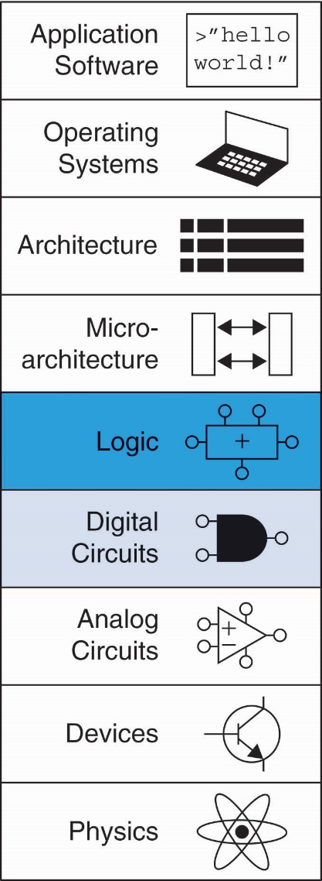
Chapter 3 :: Topics
State Elements
Bistable Circuit
SR Latch
D Latch
D Flip-Flop
Variations
Synchronous Sequential Logic
Finite State Machines
Moore
Mealy
Factored
Timing of Sequential Logic
Clock Skew
Synchronization
Parallelism

Slide 3
Chapter 3: Sequential Logic
State Elements

Slide 4
Introduction
Outputs of sequential logic depend on current and prior input values – it has memory.
Some definitions:
State: all the information about a circuit necessary to explain its future behavior
Latches and flip-flops: state elements that store one bit of state
Synchronous sequential circuits: Sequential circuits using flip-flops sharing a common clock

Slide 5
Sequential Circuits
Give sequence to events
Have memory (short-term)
Use feedback from output to input to store information

Slide 6
State Elements
State: everything about the prior inputs to the circuit necessary to predict its future behavior
Usually just 1 bit, the last value captured
State elements store state
Bistable circuit
SR Latch
D Latch
D Flip-flop

Slide 7
Chapter 3: Sequential Logic
Bistable Circuit

Slide 8
Bistable Circuit
Fundamental building block of other state elements
Two outputs: Q, Q
No inputs
Same circuit!
Back-to-back inverters
Cross-coupled inverters

Slide 9
Bistable Circuit Analysis
Consider the two possible cases:
Q = 0:
then Q = 1, Q = 0 (consistent)
Q = 1:
then Q = 0, Q = 1 (consistent)
Stores 1 bit of state in the state variable, Q (or Q)
But there are no inputs to control the state

Slide 10
Chapter 3: Sequential Logic
SR Latch

Slide 11
SR (Set/Reset) Latch
SR Latch
Consider the four possible cases:
S = 1, R = 0
S = 0, R = 1
S = 0, R = 0
S = 1, R = 1

Slide 12
SR Latch Analysis
S = 1, R = 0:
then Q = 1 and Q = 0
Set the output
S = 0, R = 1:
then Q = 0 and Q = 1
Reset the output

Slide 13
SR Latch Analysis
S = 0, R = 0:
then Q = Q_{prev}
Memory!
S = 1, R = 1:
then Q = 0, Q = 0
Invalid State
Q ≠ NOT Q

Slide 14
SR Latch
SR stands for Set/Reset Latch
Stores one bit of state (Q)
Control what value is being stored with S, R inputs
Set: Make the output 1
S = 1, R = 0, Q = 1
Reset: Make the output 0
S = 0, R = 1, Q = 0
Memory: Retain value
S = 0, R = 0, Q = Q_{prev}
Must do something to avoid invalid state (when S = R = 1)

Slide 15
Chapter 3: Sequential Logic
D Latch

Slide 16
D Latch
Two inputs: CLK, D
CLK: controls when the output changes
D (the data input): controls what the output changes to
Function
When CLK = 1,
D passes through to Q (transparent)
When CLK = 0,
Q holds its previous value (opaque)
Avoids invalid case when
Q ≠ NOT Q

Slide 17
D Latch Internal Circuit

Slide 18
Chapter 3: Sequential Logic
D Flip-Flop

Slide 19
D Flip-Flop
Inputs: CLK, D
Function:
Samples D on rising edge of CLK
When CLK rises from 0 to 1, D passes through to Q
Otherwise, Q holds its previous value
Q changes only on rising edge of CLK
Called edge-triggered
Activated on the clock edge

Slide 20
D Flip-Flop Internal Circuit
Two back-to-back D latches (L1 and L2) controlled by complementary clocks
When CLK = 0
L1 is transparent
L2 is opaque
D passes through to N1
When CLK = 1
L2 is transparent
L1 is opaque
N1 passes through to Q
Thus, on the edge of the clock (when CLK rises from 0 1)
D passes through to Q

Slide 21
D Latch vs. D Flip-Flop
D Latch
D Flip-flop

Slide 22
Chapter 3: Sequential Logic
Variations on a Flop

Slide 23
Registers: One or More Flip-flops
Easier to draw!
4-bit Register
Two ways to draw a register
4-bit Register

Slide 24
Enabled Flip-Flops
Inputs: CLK, D, EN
The enable input (EN) controls when new data (D) is stored
Function
EN = 1: D passes through to Q on the clock edge
EN = 0: the flip-flop retains its previous state

Slide 25
Resettable Flip-Flops
Inputs: CLK, D, Reset
Function:
Reset = 1: Q is forced to 0
Reset = 0: flip-flop behaves as ordinary D flip-flop

Slide 26
Resettable Flip-Flops
Two types:
Synchronous: resets at the clock edge only
Asynchronous: resets immediately when Reset = 1
Asynchronously resettable flip-flop requires changing the internal circuitry of the flip-flop
Synchronously resettable flip-flop?

Slide 27
Settable Flip-Flops
Inputs: CLK, D, Set
Function:
Set = 1: Q is set to 1
Set = 0: the flip-flop behaves as ordinary D flip-flop

Slide 28
Chapter 3: Sequential Logic
Synchronous Sequential Logic

Slide 29
Sequential Logic
Sequential circuits: all circuits that aren’t combinational
A problematic circuit:
No inputs and 1-3 outputs
Astable circuit, oscillates
Period depends on inverter delay
It has a cyclic path: output fed back to input

Slide 30
Synchronous Sequential Logic Design
Breaks cyclic paths by inserting registers
Registers contain state of the system
State changes at clock edge: system synchronized to the clock
Rules of synchronous sequential circuit composition:
Every circuit element is either a register or a combinational circuit
At least one circuit element is a register
All registers receive the same clock
Every cyclic path contains at least one register
Two common synchronous sequential circuits
Finite State Machines (FSMs)
Pipelines

Slide 31
Synchronous Sequential Logic Design
Breaks cyclic paths by inserting registers
Registers contain state of the system
State changes at clock edge: system synchronized to the clock
Rules of synchronous sequential circuit composition:
Every circuit element is either a register or a combinational circuit
At least one circuit element is a register
All registers receive the same clock
Every cyclic path contains at least one register
Two common synchronous sequential circuits
Finite State Machines (FSMs)
Pipelines

Slide 32
Chapter 3: Sequential Logic
FSMs:
Finite State Machines

Slide 33
Finite State Machine (FSM)
Consists of:
State register
Stores current state
Loads next state at clock edge
Combinational logic
Computes the next state
Computes the outputs

Slide 34
Finite State Machines (FSMs)
Next state determined by current state and inputs
Two types of finite state machines differ in output logic:
Moore FSM: outputs depend only on current state
Mealy FSM: outputs depend on current state and inputs

Slide 35
Finite State Machines (FSMs)
Next state determined by current state and inputs
Two types of finite state machines differ in output logic:
Moore FSM: outputs depend only on current state
Mealy FSM: outputs depend on current state and inputs

Slide 36
FSM Design Procedure
Identify inputs and outputs
Sketch state transition diagram
Write state transition table and output table
Moore FSM: write separate tables
Mealy FSM: write combined state transition and output table
Select state encodings
Rewrite state transition table and output table with state encodings
Write Boolean equations for next state and output logic
Sketch the circuit schematic

Slide 37
FSM Design Procedure
Identify inputs and outputs
Sketch state transition diagram
Write state transition table and output table
Moore FSM: write separate tables
Mealy FSM: write combined state transition and output table
Select state encodings
Rewrite state transition table and output table with state encodings
Write Boolean equations for next state and output logic
Sketch the circuit schematic

Slide 38
Chapter 3: Sequential Logic
Moore FSM Example

Slide 39
FSM Example
Traffic light controller
Traffic sensors: T_{A}, T_{B} (TRUE when there’s traffic)
Lights: L_{A}, L_{B}

Slide 40
FSM Black Box
Inputs: CLK, Reset, T_{A}, T_{B}
Outputs: L_{A}, L_{B}

Slide 41
FSM State Transition Diagram
Moore FSM: outputs labeled in each state
States: Circles
Transitions: Arcs

Slide 42
FSM State Transition Table
Current State | Inputs |  | Next State
S | T_{A} | T_{B} | S'
S0 | 0 | X | S1
S0 | 1 | X | S0
S1 | X | X | S2
S2 | X | 0 | S3
S2 | X | 1 | S2
S3 | X | X | S0
S : Current State
S’: Next State

Slide 43
FSM Encoded State Transition Table
Current State |  | Inputs |  | Next State
S₁ | S₀ | T_{A} | T_{B} | S'₁ | S'₀
0 | 0 | 0 | X | 0 | 1
0 | 0 | 1 | X | 0 | 0
0 | 1 | X | X | 1 | 0
1 | 0 | X | 0 | 1 | 1
1 | 0 | X | 1 | 1 | 0
1 | 1 | X | X | 0 | 0
S0
S1
S0
S0
S1
S2
S2
S3
S2
S2
S3
S0
State | Encoding
S0 | 00
S1 | 01
S2 | 10
S3 | 11
S'₁ = S₁S₀ + S₁S₀T_{B} + S₁S₀T_{B} = S₁S₀ + S₁S₀ = S₁ ⊕ S₀
S'₀ = S₁S₀T_{A} + S₁S₀T_{B}

Slide 44
FSM Output Table
Current State |  | Outputs
S₁ | S₀ | L_{A1} | L_{A0} | L_{B1} | L_{B0}
0 | 0 | 0 | 0 | 1 | 0
0 | 1 | 0 | 1 | 1 | 0
1 | 0 | 1 | 0 | 0 | 0
1 | 1 | 1 | 0 | 0 | 1
S0
green
red
S1
yellow
red
S2
red
green
S3
red
yellow
Output | Encoding
green | 00
yellow | 01
red | 10
L_{A1} = S₁S₀ + S₁S₀ = S₁
L_{A0} = S₁S₀
L_{B1} = S₁S₀ + S₁S₀ = S₁
L_{B0} = S₁S₀

Slide 45
FSM Schematic
Next State
Current State
Next State Logic
State Register
Output Logic
S'₁ = S₁ ⊕ S₀
S'₀ = S₁S₀T_{A} + S₁S₀T_{B}
L_{A1} = S₁
L_{A0} = S₁S₀
L_{B1} = S₁
L_{B0} = S₁S₀

Slide 46
FSM Timing Diagram

Slide 47
FSM Timing Diagram

Slide 48
State Encodings
Binary encoding:
i.e., for four states, 00, 01, 10, 11
One-hot encoding
One state bit per state
Only one state bit HIGH at once
i.e., for 4 states, 0001, 0010, 0100, 1000
Requires more flip-flops
Often next state and output logic is simpler

Slide 49
1-Hot State Encoding Example
Current State |  |  |  | Inputs |  | Next State
S₃ | S₂ | S₁ | S₀ | T_{A} | T_{B} | S’₃ | S’₂ | S’₁ | S’₀
0 | 0 | 0 | 1 | 0 | X | 0 | 0 | 1 | 0
0 | 0 | 0 | 1 | 1 | X | 0 | 0 | 0 | 1
0 | 0 | 1 | 0 | X | X | 0 | 1 | 0 | 0
0 | 1 | 0 | 0 | X | 0 | 1 | 0 | 0 | 0
0 | 1 | 0 | 0 | X | 1 | 0 | 1 | 0 | 0
1 | 0 | 0 | 0 | X | X | 0 | 0 | 0 | 1
S0
S1
S0
S0
S1
S2
S2
S3
S2
S2
S3
S0
S’₃ = S₃S₂S₁S₀T_{B}
State | 1-Hot Encoding
S0 | 0001
S1 | 0010
S2 | 0100
S3 | 1000
S’₃ = S₂T_{B}
S’₂ = S₁ + S₂T_{B}
S’₁ = S₀T_{A}
S’₀ = S₀T_{A} + S₃
NO!

Slide 50
Chapter 3: Sequential Logic
Mealy FSM Example

Slide 51
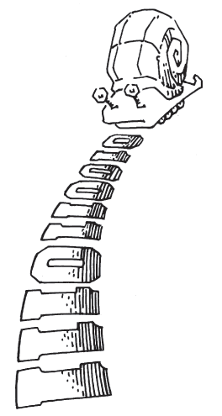
Moore vs. Mealy FSMs
Alyssa P. Hacker has a snail that crawls down a paper tape with 1’s and 0’s on it. The snail smiles whenever the last two digits it has crawled over are 01. Design Moore and Mealy FSMs of the snail’s brain.

Slide 52
State Transition Diagrams

Slide 53
Moore FSM State Transition Table
Current State |  | Inputs | Next State
S₁ | S₀ | A | S'₁ | S'₀
0 | 0 | 0 | 0 | 1
0 | 0 | 1 | 0 | 0
0 | 1 | 0 | 0 | 1
0 | 1 | 1 | 1 | 0
1 | 0 | 0 | 0 | 1
1 | 0 | 1 | 0 | 0
State | Encoding
S0 | 00
S1 | 01
S2 | 10
S₁’ = S₀A
S₀’ = A
S₁’ = S₁S₀A
S₀’ = A

Slide 54
Moore FSM Output Table
Current State |  | Output
S₁ | S₀ | Y
0 | 0 | 0
0 | 1 | 0
1 | 0 | 1
State | Encoding
S0 | 00
S1 | 01
S2 | 10
Y = S₁
Y = S₁ S₀

Slide 55
Mealy State Transition & Output Table
Current State | Input | Next State | Output
S₀ | A | S'₀ | Y
0 | 0 | 1 | 0
0 | 1 | 0 | 0
1 | 0 | 1 | 0
1 | 1 | 0 | 1
State | Encoding
S0 | 0
S1 | 1
S₀’ = A
Y = S₀ A

Slide 56
Moore FSM Schematic
Next State Equations
S₁’ = S₀A
S₀’ = A
Output Equation
Y = S₁

Slide 57
Mealy FSM Schematic
Next State Equation
S₀’ = A
Output Equation
Y = S₀A

Slide 58
Moore and Mealy Timing Diagram
Mealy FSM: asserts Y immediately when input pattern 01 is detected
Moore FSM: asserts Y one cycle after input pattern 01 is detected

Slide 59
Chapter 3: Sequential Logic
Factored FSMs

Slide 60
Factoring FSMs
Break complex FSMs into smaller interacting FSMs
Example: Modify traffic light controller to have Parade Mode.
Two more inputs: P, R
When P = 1, enter Parade Mode & Bravado Blvd light stays green
When R = 1, leave Parade Mode

Slide 61
Parade FSMs
Unfactored FSM
Factored FSM

Slide 62
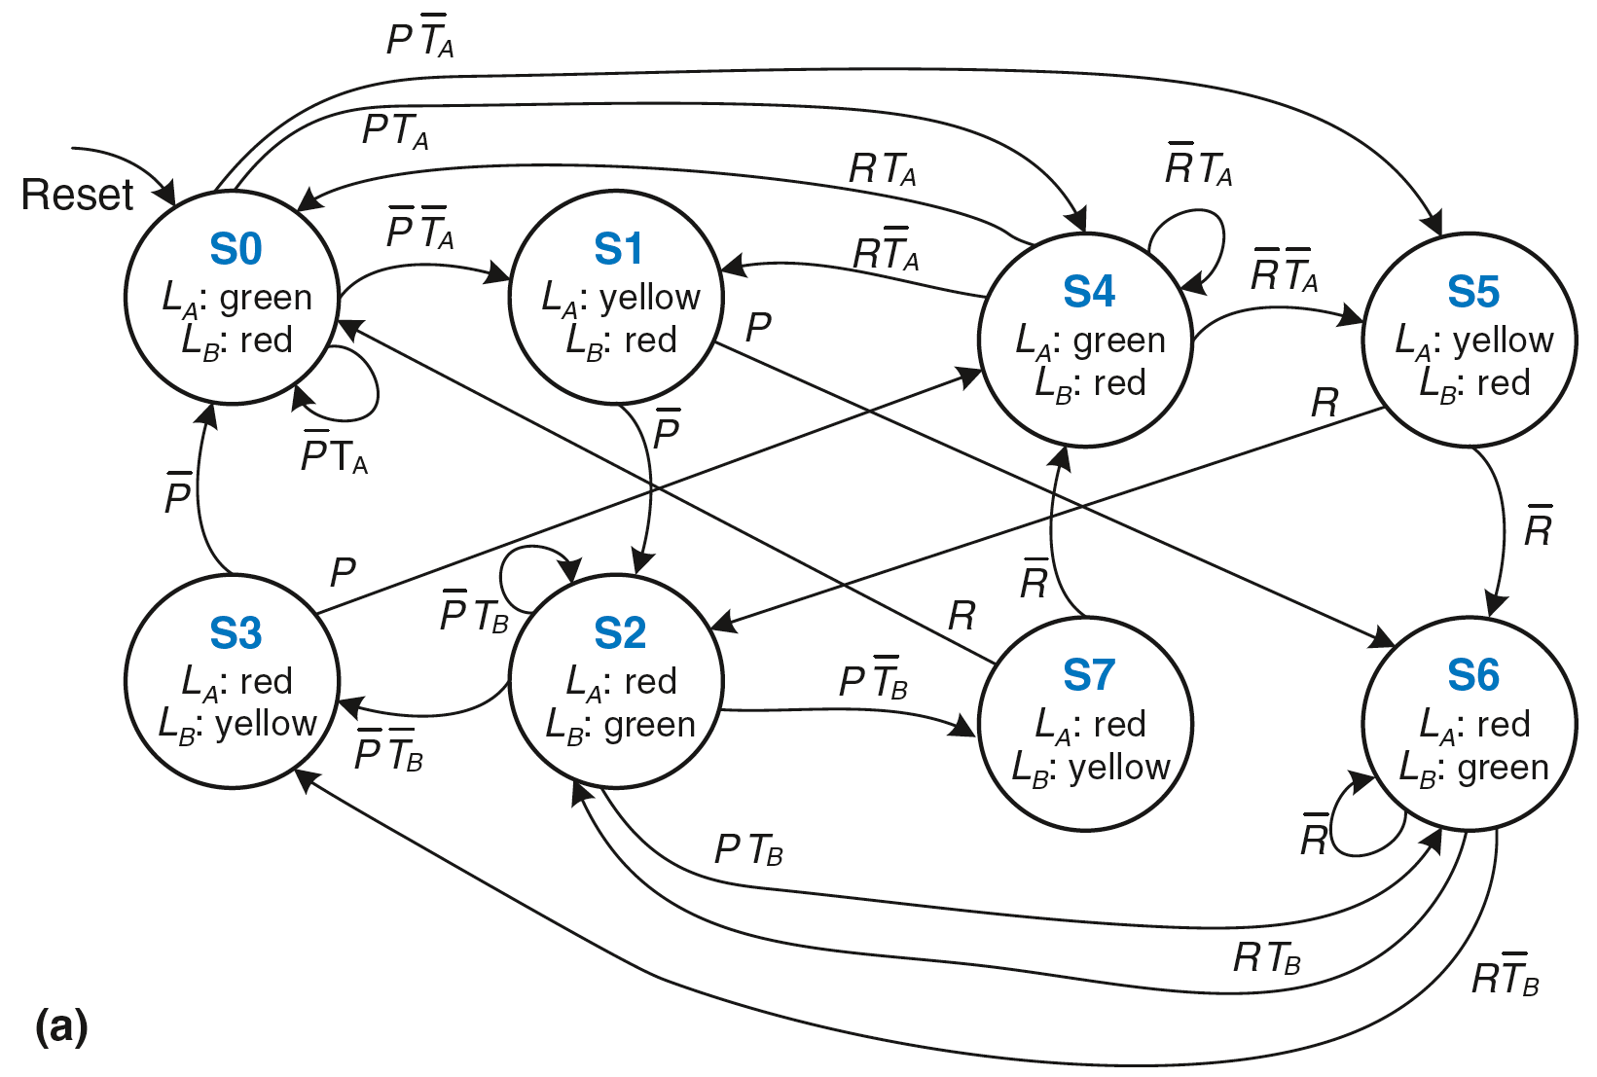
Unfactored FSM

Slide 63
Factored FSM

Slide 64
Chapter 3: Sequential Logic
Timing

Slide 65
Timing
Flip-flop samples D at clock edge
D must be stable when sampled
Similar to a photograph, D must be stable around clock edge

Slide 66
Input Timing Constraints
Setup time: t_{setup} = time before clock edge data must be stable (i.e. not changing)
Hold time: t_{hold} = time after clock edge data must be stable
Aperture time: t_{a} = time around clock edge data must be stable (t_{a} = t_{setup} + t_{hold})

Slide 67
Output Timing Constraints
Propagation delay: t_{pcq} = time after clock edge that Q is guaranteed to be stable (i.e., to stop changing): maximum delay
Contamination delay: t_{ccq} = time after clock edge that Q might be unstable (i.e., start changing): minimum delay

Slide 68
Dynamic Discipline
Synchronous sequential circuit inputs must be stable during aperture (setup and hold) time around clock edge
Specifically, inputs must be stable
at least t_{setup} before the clock edge
at least until t_{hold} after the clock edge

Slide 69
Dynamic Discipline
The delay between registers has a minimum and maximum delay, dependent on the delays of the circuit elements

Slide 70
Setup Time Constraint
Depends on the maximum delay from register R1 through combinational logic to R2
The input to register R2 must be stable at least t_{setup} before clock edge
Also called:
Cycle Time Constraint
T_{c} ≥ t_{pcq} + t_{pd} + t_{setup}
t_{pd} ≤ T_{c} – (t_{pcq} + t_{setup})
(t_{pcq} + t_{setup}):
sequencing overhead

Slide 71
Hold Time Constraint
Depends on the minimum delay from register R1 through the combinational logic to R2
The input to register R2 must be stable for at least t_{hold} after the clock edge
t_{hold} < t_{ccq} + t_{cd}
t_{cd} > t_{hold} - t_{ccq}

Slide 72
Timing Analysis
Calculate both constraints:
Setup time constraint (aka cycle time constraint)
Hold time constraint
If the hold time constraint isn’t met, the circuit won’t work reliably at any frequency

Slide 73
Timing Analysis Example
Timing Characteristics
t_{ccq} = 30 ps
t_{pcq} = 50 ps
t_{setup} = 60 ps
t_{hold} = 70 ps
t_{pd} = 35 ps
t_{cd} = 25 ps
Flip-Flops
Logic delays:
per gate
t_{pd} = 3 x 35 ps = 105 ps
t_{cd} = 25 ps
Setup time constraint:
T_{c} ≥ (50 + 105 + 60) ps = 215 ps
f_{c} = 1/T_{c} = 4.65 GHz
Hold time constraint:
t_{ccq} + t_{cd} > t_{hold} ?
(30 + 25) ps > 70 ps ? No!
T_{c} ≥ t_{pcq} + t_{pd} + t_{setup}
Won’t run reliably at any frequency

Slide 74
Timing Analysis Example
How to fix?
Add buffers on short paths
Timing Characteristics
t_{ccq} = 30 ps
t_{pcq} = 50 ps
t_{setup} = 60 ps
t_{hold} = 70 ps
t_{pd} = 35 ps
t_{cd} = 25 ps
Flip-Flops
Logic delays:
per gate
t_{pd} = 3 x 35 ps = 105 ps
t_{cd} = 2 x 25 ps = 50 ps
Setup time constraint:
T_{c} ≥ (50 + 105 + 60) ps = 215 ps
f_{c} = 1/T_{c} = 4.65 GHz
Hold time constraint:
t_{ccq} + t_{cd} > t_{hold} ?
(30 + 50) ps > 70 ps ? Yes!

Slide 75
Chapter 3: Sequential Logic
Clock Skew

Slide 76
Clock Skew
The clock doesn’t arrive at all registers at same time
Skew: difference between two clock edges
Perform worst case analysis to guarantee dynamic discipline is not violated for any register – many registers in a system!

Slide 77
Setup Time Constraint with Skew
In the worst case, CLK2 is earlier than CLK1
T_{c} - t_{skew} ≥ t_{pcq} + t_{pd} + t_{setup}
T_{c} ≥ t_{pcq} + t_{pd} + t_{setup} + t_{skew}
t_{pd} ≤ T_{c} – (t_{pcq} + t_{setup} + t_{skew})

Slide 78
Hold Time Constraint with Skew
In the worst case, CLK2 is later than CLK1
t_{ccq} + t_{cd} > t_{hold} + t_{skew}
t_{cd} > t_{hold} + t_{skew} – t_{ccq}

Slide 79
Chapter 3: Sequential Logic
Synchronization

Slide 80
Violating the Dynamic Discipline
Asynchronous (for example, user) inputs might violate the dynamic discipline

Slide 81
Metastability
Bistable devices: two stable states, and a metastable state between them
Flip-flop: two stable states (1 and 0) and one metastable state
If flip-flop lands in metastable state, could stay there for an undetermined amount of time

Slide 82
Flip-Flop Internals
Flip-flop has feedback: if Q is somewhere between 1 and 0, cross-coupled gates drive output to either rail (1 or 0)
Metastable signal: if it hasn’t resolved to 1 or 0
If flip-flop input changes at random time, probability that output Q is metastable after waiting some time, t:
P(t_{res} > t) = (T₀/T_{c} ) e^{-t/τ}
t_{res} : time to resolve to 1 or 0
T₀, τ : properties of the circuit

Slide 83
Metastability
Intuitively:
T₀/T_{c}: probability input changes at a bad time (during aperture time)
P(t_{res} > t) = (T₀/T_{c} ) e^{-t/τ}
τ: time constant for how fast flip-flop moves away from metastability
P(t_{res} > t) = (T₀/T_{c} ) e^{-t/τ}
If flip-flop samples metastable input, if you wait long enough (t), the output will have resolved to 1 or 0 with high probability.

Slide 84
Synchronizers
Asynchronous inputs are inevitable (user interfaces, systems with different clocks interacting, etc.)
Synchronizer goal: make the probability of failure (the output Q still being metastable) low
Synchronizer cannot make the probability of failure 0

Slide 85
Synchronizer Internals
Synchronizer: built with two back-to-back flip-flops
Suppose D is transitioning when sampled by F1
Internal signal D2 has (T_{c} - t_{setup}) time to resolve to 1 or 0

Slide 86
Synchronizer Internals
Synchronizer: built with two back-to-back flip-flops
Suppose D is transitioning when sampled by F1
Internal signal D2 has (T_{c} - t_{setup}) time to resolve to 1 or 0

Slide 87
Synchronizer Probability of Failure
For each sample, probability of failure is:
P(failure) = (T₀/T_{c} ) e^{-(Tc} ^{- tsetup)/τ}

Slide 88
Synchronizer Mean Time Between Failure
If asynchronous input changes once per second, probability of failure per second is P(failure).
If input changes N times per second, probability of failure per second is:
P(failure)/second = (NT₀/T_{c}) e^{-(Tc} ^{- tsetup)/τ}
Synchronizer fails, on average, 1/[P(failure)/second]
Called mean time between failures, MTBF:
MTBF = 1/[P(failure)/second] = (T_{c}/NT₀) e^{(Tc} ^{- tsetup)/τ}

Slide 89
Example Synchronizer
Suppose: T_{c} = 1/500 MHz = 2 ns τ = 200 ps
T₀ = 150 ps t_{setup} = 100 ps
N = 10 events per second
What is the probability of failure? MTBF?
P(failure) = (150 ps/2 ns) e^{-(1.9 ns)/200 ps}
= 5.6 × 10⁻⁶
P(failure)/second = 10 × (5.6 × 10⁻⁶ )
= 5.6 × 10⁻⁵ / second
MTBF = 1/[P(failure)/second] ≈ 5 hours
P(failure)/second = (NT₀/T_{c}) e^{-(Tc} ^{- tsetup)/τ}
MTBF = 1/[P(failure)/second]

Slide 90
Chapter 3: Sequential Logic
Parallelism

Slide 91
Parallelism
Two types of parallelism:
Spatial parallelism
duplicate hardware performs multiple tasks at once
Temporal parallelism
task is broken into multiple stages
also called pipelining
for example, an assembly line

Slide 92
Parallelism
Token: Group of inputs processed to produce group of outputs
Latency: Time for one token to pass from start to end
Throughput: Number of tokens produced per unit time
Parallelism increases throughput

Slide 93
Parallelism Example
Ben Bitdiddle bakes cookies to celebrate traffic light controller installation
5 minutes to roll cookies
15 minutes to bake
What is the latency and throughput without parallelism?
Latency = 5 + 15 = 20 minutes = 1/3 hour
Throughput = 1 tray/ 1/3 hour = 3 trays/hour

Slide 94
Parallelism Example
What is the latency and throughput if Ben uses parallelism?
Spatial parallelism: Ben asks Allysa P. Hacker to help, using her own oven
Temporal parallelism:
two stages: rolling and baking
He uses two trays
While first batch is baking, he rolls the second batch, etc.

Slide 95
Spatial Parallelism
Latency = 5 + 15 = 20 minutes = 1/3 hour
Throughput = 2 trays/ 1/3 hour = 6 trays/hour

Slide 96
Temporal Parallelism
Latency = 5 + 15 = 20 minutes = 1/3 hour
Throughput = 1 trays/ 1/4 hour = 4 trays/hour
Using both techniques, the throughput would be 8 trays/hour

Slide 97
About these Notes
Digital Design and Computer Architecture Lecture Notes
© 2021 Sarah Harris and David Harris
These notes may be used and modified for educational and/or non-commercial purposes so long as the source is attributed.
97

